Slide 1

Windows 2000 Operating System
Introduction
Computing Department,
Lancaster University, UK

Slide 2
Overview
Goals
  Overview Windows 2000 and product variations
  Introduce key Windows 2000 concepts such as the Win32 API, processes, threads, virtual memory, kernel mode and user mode
  Introduce tools that can be used to examine Windows 2000 internal behaviour

Slide 3
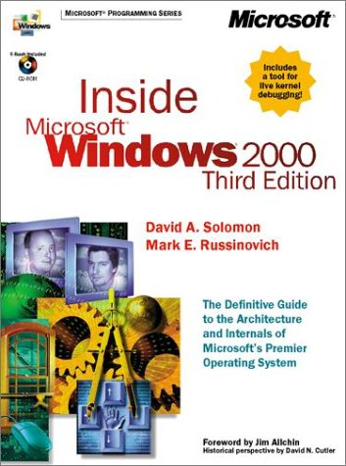
Course Textbook
This book has been used as a basis for much of the material you will find within this course
By far the best textbook in this area – buy it!

Slide 4
Introduction

Slide 5
Brief History of Windows (1)
Windows 1.0
  Announced in 1983, released in November 1985
Windows 2.0
  Released in 1987
  New feature: overlapping Windows!
  Required Intel 8086 or 8088 Processor
  Could access 1 megabyte of memory
Windows 3.0
  Introduced on May 22, 1990
  Big change: Supported 16-bit protected mode (Intel 286/386 processors)
  Could access upto 16 megabytes of memory

Slide 6
Brief History of Windows (2)
Windows 3.1
  Released in April 1992
  TrueType fonts (scalable)
  Multimedia
  Ran only in protected mode
  Required 286/386 with > 1MB of memory
Windows NT
  Introduced in July 1993
  First Windows version supporting 32-bit mode of Intel 386, 486 and Pentium processors
  Designed to be portable to non-Intel processors

Slide 7
Brief History of Windows (3)
Windows 95
  Introduced in August 1995
  Also supported 32-bit programming mode
Windows 98
  Released in June 1998
  Performance improvements & hardware support
  Internet Integration
Windows 2000
  Introduced in February 2000
Windows Millennium
  Released in September 2000

Slide 8
What is Windows 2000? (1)
Protected, virtual memory, 32-bit operating system
  Separate, protected per-process address space
  Preemptive, multithreaded multitasking
  Symmetric multiprocessing: 2-32 CPUs
Modern O/S features and functionality
  Design started in 1989
  Microkernel(-ish) architecture
  C2 security (US Dept. of Defence)
  High performance, robust file system
  Full support for UNICODE (www.unicode.org)
    Defines unique 16-bit values for the world’s character sets

Slide 9
What is Windows 2000? (2)
Designed to be portable
  Originally supported x86, MIPS, Alpha and PowerPC
  Now only x86 (IA-64 Intel Itanium support in future)
Integrated networking
  Peer to peer bundled (similar to Windows 9x)
  2000 Server adds enterprise-wide capability (domains)
  5 transports: NetBeui, TCP/IP, IPX/SPX, AppleTalk, DLC
Multiple O/S personalities
  Win32, OS/2 1.x character mode, POSIX subsystems
  Win32 is “primary” environment

Slide 10
Windows 2000 vs. Windows 9x (1)
Windows 2000
  Requirement: O/S stability, applications protected from each other, O/S protected from applications
  Goal: Runs “most” 16-bit DOS and Win16 business applications
  Long term desktop and server OS for Microsoft
Windows 9x
  Requirement: Runs all 16-bit DOS and Win16 applications, including games and device drivers
  Still contains a lot of 16-bit code (graphic & windowing system)
  Many 32-bit APIs call 16-bit code in the Win9x kernel

Slide 11
Windows 2000 vs. Windows 9x (2)
Windows 2000 supports symmetric multiprocessing (SMP)
  No master processor: OS and user threads can be scheduled to run on any processor
Windows 2000 filing system supports security
Windows 2000 is fully 32-bit
  Windows 9x contains lots of 16-bit code
Windows 2000 is fully reentrant
  Significant portions of 9x are nonreentrant
Windows 2000 can’t run all older MS-DOS/Windows applications (direct hardware access)

Slide 12
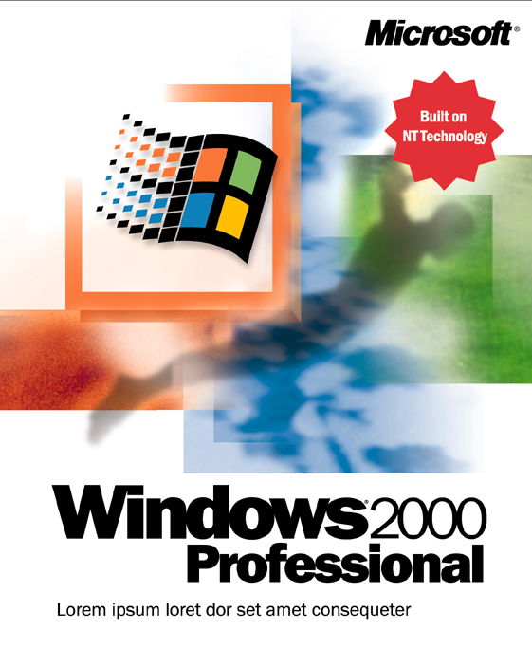
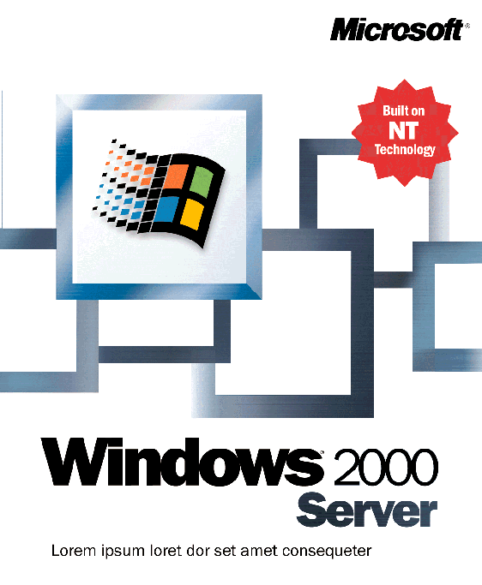
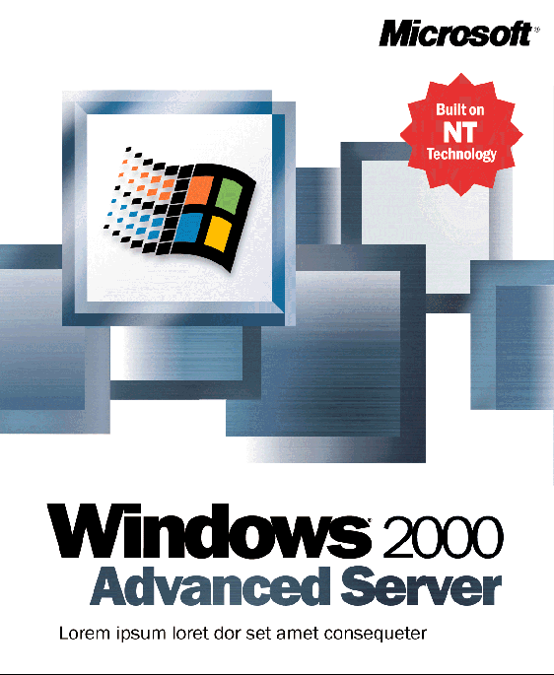
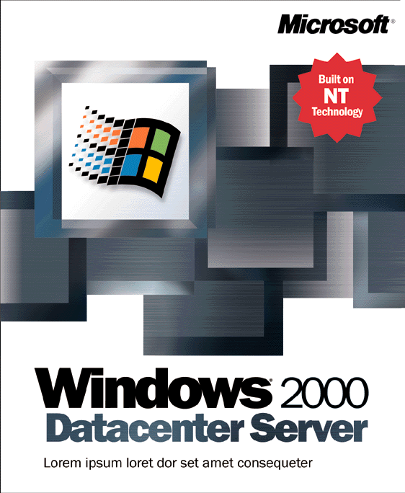
Product Packaging
Windows 2000 Professional
  Desktop version
  Licensed for 2CPUs, 4GB RAM
Windows 2000 Server
  Superset of Win2K Professional
  Adds Server and Networking Functionality (Domains, DNS)
Windows 2000 Advanced Server
  Licensed for 8 CPUs, 8GB RAM
Windows 2000 Datacenter Server
  4 node clusters
  Licensed for 32 CPUs, 64GB RAM

Slide 13
Key Concepts

Slide 14
Win32 Application Programming Interface (API)
Primary programming interface to Microsoft Windows operating systems (95, 98, 2000, CE)
Think “Win32.EXE”, not “Windows 2000.EXE”
Windows 2000 is designed to support multiple programming interfaces using environment systems
Win32 Application .EXE
Win32 API
Win32s
Windows 95/98/
Millennium
Windows 2000
Win 3.1/DOS

Slide 15



Processes, Threads and Jobs
Executive
Executive
What is a process?
  Represents an instance of a running program
    You create a process to run a program
    Starting an application creates a process
What is a thread?
    An execution context within a process
    All threads in a process share the same per-process address space
What is a job?
    Allows groups of process to be managed as a single unit
Per-process
address space
Thread
Thread
Thread
Systemwide
Address Space

Slide 16
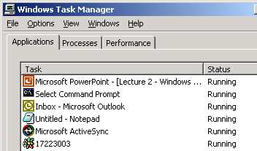
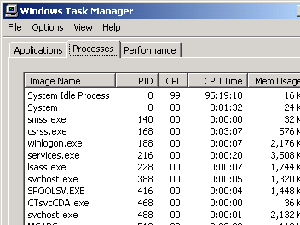
Task Manager
To start: Ctrl+Alt+Del or right click on empty area of task bar
Applications tab:
    Lists visible windows owned by threads
Processes tab:
    Lists processes
    Change priority
Performance tab:
    Subset of performance counters

Slide 17
Virtual Memory
Virtual address space = logical view
Memory manager translates virtual addresses into physical addresses
Paging transfers some memory contents to disk, freeing physical memory
Virtual Memory
Physical Memory

Slide 18
Kernel Mode vs. User Mode (1)
Operating System Modes
  Kernel Mode (OS)
    Privileged process mode
    Access to system data/hardware
  User Mode (Applications)
    Nonprivileged processor mode
    Limited access to system data/no direct hardware access
Applications separated from the operating system – prevented from modifying critical data
However, OS components/device drivers can still corrupt system!

Slide 19

Kernel Mode vs. User Mode (2)
Finding process with Most Kernel-Mode Time
  Run Performance Monitor (perfmon.exe)
  Click on “+” (add counter)
  Select “Process” as Performance Object
  Click on %Privileged Time
  Select all processes in Instance box (except _Total)
  Click on “Add”, click on “Close”
  Use up/down arrow keys to scroll through counters (type CTRL/H to turn on highlighting)

Slide 20
Kernel Mode vs. User Mode (3)
Compare time spent in kernel mode vs. user mode
  Run Performance Monitor (perfmon.exe)
  Click on “+” (add counter)
  Select “Process” as Performance Object
  Click on %Privileged Time and, whilst holding Ctrl, click the %User Time counter
  Click on “Add”, click on “Close”
  Move mouse rapidly, and watch how the %Privileged Time and %User Time counters increase

Slide 21
Windows 2000 Registry
Repository for system/user configuration information
  Contains information Windows 2000 requires to boot & configure as well as current running system dynamic status information
Most common registry parameters can be adjusted using a graphical utility
  Advanced tuning/configuration requires direct access
    Regedt32 or Regedit
Organised to “hives”
  Pieces of the registry database stored in different files

Slide 22
Windows 2000 Registry
Repository for system/user configuration information
  Contains information Windows 2000 requires to boot & configure as well as current running system dynamic status information
Most common registry parameters can be adjusted using a graphical utility
  Advanced tuning/configuration requires direct access
    Regedt32 or Regedit
Organised to “hives”
  Pieces of the registry database stored in different files

Slide 23
Registry Organisation
Five main hives for location machine information
  \HKEY_LOCAL_MACHINE\System
    Controls booting and running the system
  \HKEY_LOCAL_MACHINE\Hardware
    Hardware configuration data, resource usage
    Volatile (not saved across boots)
  \HKEY_LOCAL_MACHINE\Software
    Per-machine software data (not critical for booting)
  \HKEY_LOCAL_MACHINE\SAM
    Account & groups database (replicated on domain controllers)
  \HKEY_LOCAL_MACHINE\Security
    System-wide security policies (on domain controllers)
Try regmon!

Slide 24
Windows 2000 Professional vs. Server vs. Advanced Server
Core operating system executables are identical
Registry indicates system type (set at install time)
  HKEY_LOCAL_MACHINE\System\CurrentControlSet\Control\ProductOptions
    ProductType: WinNT=Workstation, ServerNT=Server, LanManNT=Server (Domain Controller)
Code in the OS tests these values and behaves slightly differently in a few places
  Licensing limits (no. of processors)
  Boot-time calculations (Memory Manager)
  Length of a time slice

Slide 25
Tools Preview
Tool | Executable |  | Functionality
Performance Monitor | perfmon | Bundled with 2000 | System Monitoring, Viewing Performance Counter Logs
Task Manager | taskman | Bundled with 2000 | Provides information about processes and performance
Process Viewer | pview | Resource Kit | Shows processes and thread details
Tlist | tlist | Resource Kit | Shows process tree and thread details
Registry Monitor | regmon | Inside Windows 2000 | Monitor registry activity
File Monitor | filemon | Inside Windows 2000 | Monitor file system activity

